Slide 1
Plastic Waste Reduction
Sustainability Moment
Date of your sustainability moment

Slide 2
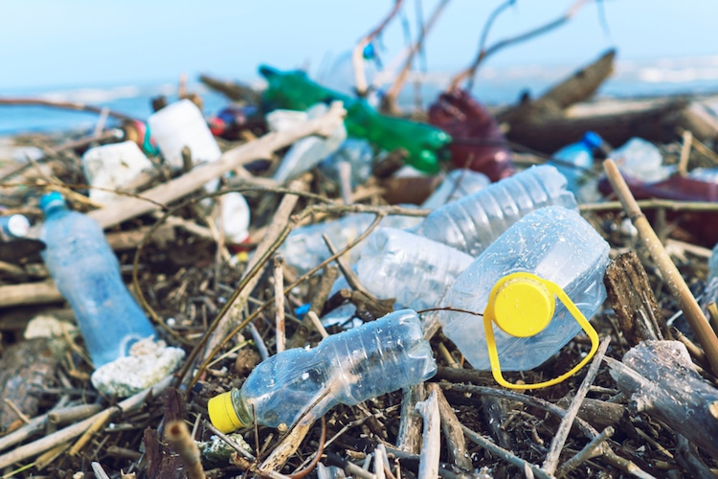
Plastic Waste Reduction: What’s the problem?
Global plastic production is likely to skyrocket over next 10-15 years -- but only 9% of all plastic ever made has been recycled
13 million tonnes of plastic waste enter oceans every year
  90% of bottled water and 83% of tap water contain microplastic particles
Nearly 57 million plastic straws are used across Canada every day
  Straws can take 500 years to decompose in landfill
Notes:
References:
- United Nations Environment Programme. “The State of Plastics: World Environment Day Outlook 2018.” <https://wedocs.unep.org/bitstream/handle/20.500.11822/25513/state_plastics_WED.pdf?sequence=1&isAllowed=y>
- City of Vancouver. “Policy Report: Single-Use Item Reduction Strategy.” <https://council.vancouver.ca/20180516/documents/pspc2b.pdf>

Slide 3
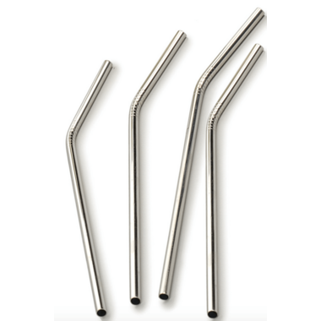
Plastic Waste Reduction: How can we help?
Refuse, reduce, reuse:
  UCalgary restaurants (LDL, The Den) no longer provide plastic straws with drinks unless asked
  Carrying a reusable straw makes it easier to refuse single-use plastics in your daily life
Share your views on plastic waste reduction with your city councillor
Visit the Sustainability Resource Centre (SB101) to learn more about plastic waste!
Notes:
Link in second bullet links to City of Calgary “Find your Councillor” webpage.

